Slide 1
MUNICIPAL SOLID WASTE MANAGEMENT
Prepared by
S.Nathiya
Assistant Professor/Civil Engineering

Slide 2
EN6501 MUNICIPAL SOLID WASTE MANAGEMENT
OBJECTIVES:
To make the students conversant with different aspects of the types, sources, generation, storage, collection, transport, processing and disposal of municipal solid waste.
The student is expected to know about the various effects and disposal options for the municipal solid waste.

Slide 3
OUTCOMES:
The students completing the course will have
an understanding of the nature and characteristics of municipal solid wastes and the regulatory requirements regarding municipal solid waste management
ability to plan waste minimisation and design storage, collection, transport, processing and disposal of municipal solid waste

Slide 4
TEXTBOOKS:
1. Tchobanoglous, G., Theisen, H. M., and Eliassen, R. "Solid. Wastes: Engineering Principles and Management Issues". McGraw Hill, New York, 1993.
2. Vesilind, P.A. and Rimer, A.E., “Unit Operations in Resource Recovery Engineering”, Prentice Hall, Inc., 1981
3. Paul T Willams, "Waste Treatment and Disposal", John Wiley and Sons, 2000
REFERENCES:
1. Government of India, "Manual on Municipal Solid Waste Management", CPHEEO, Ministry of Urban Development, New Delhi, 2000.
2. Bhide A.D. and Sundaresan, B.B. "Solid Waste Management Collection", Processing and Disposal, 2001
3. Manser A.G.R. and Keeling A.A.," Practical Handbook of Processing and Recycling of Municipal solid Wastes", Lewis Publishers, CRC Press, 1996
4. George Tchobanoglous and Frank Kreith"Handbook of Solidwaste Management", McGraw Hill, New York, 2002

Slide 5
Municipal Solid Waste Management: Glossary
Aerobic composting: a method of com-posting organic wastes using bacteria that need oxygen.
Anaerobic digestion: a method of composting that does not require oxygen. This composting method produces methane. Also known as anaerobic composting.
Ash: the non-combustible solid by-products of incineration or other burning process.
Bale: A large block of recyclables held together with plastic strapping.
Biodegradable: Capable of decomposing rapidly by microorganisms under natural conditions (aerobic and/or anaerobic).
Biogas: Gas formed by digestion of organic materials. Typically dominated by CH₄ and CO₂ in a landfill.

Slide 6
Bioconversion: A general term describing the conversion of one form of energy into another by plants or microorganisms. An example is the digestion of solid wastes or sewage sludge by microorganisms to form methane.
Bulky waste: large wastes such as appliances, furniture, and trees and branches, that cannot be handled by normal MSW processing methods.
Buy-back centre : A place to sell recyclable materials.
Cell: An area in a landfill where solid waste is disposed of each day.
Collection: the process of picking up wastes from residences, businesses, or a collection point, loading them into a vehicle, and transporting them to a processing, transfer, or disposal site.
Combustion: in MSWM, the burning of materials in an incinerator.

Slide 7
Commingled: mixed recyclables that are collected together after having been separated from mixed MSW.
Communal collection: a system of collection in which individuals bring their waste directly to a central point, from which it is collected.
Compaction: Reduction of the bulk of municipal solid waste and increasing its density through a physical process such as rolling or tamping or as a result of waste compacting under its own weight.
Compactor vehicle: a collection vehicle using high-power mechanical or hydraulic equipment to reduce the volume of solid waste.
Compost: the material resulting from composting. Compost, also called humus, is a soil conditioner and in some instances is used as a fertilizer.
Composting: biological decomposition of solid organic materials by bacteria, fungi, and other organisms into a soil-like product.
Construction and demolition debris: waste generated by construction and demolition of buildings, such as bricks, concrete, drywall, lumber, miscellaneous metal parts and sheets, packaging materials, etc.

Slide 8
Curb side collection: collection of compostable, recyclables, or trash at the edge of a sidewalk in front of a residence or shop.
Controlled dump: a planned landfill that incorporates to some extent some of the features of a sanitary landfill: siting with respect to hydrogeological suitability, grading, compaction in some cases, leachate control, partial gas management, regular (not usually daily) cover, access control, basic record-keeping, and controlled waste picking.
Dead Animals: They are big and small animals that are putrescible if not removed and disposed properly.
Disposal: the final handling of solid waste, following collection, processing, or incineration. Disposal most often means placement of wastes in a dump or a landfill.
Drop-off centre: an area or facility for receiving compostables or recyclables that are dropped off by waste generators.
Dump: A site used to dispose of municipal solid waste without management and/or environmental controls.
Domestic Waste: It comprises kitchen wastes, ashes from fires, broken utensils and worn out clothing.

Slide 9
Emissions: gases released into the atmosphere.
Energy recovery: the process of extracting useful energy from waste, typically from the heat produced by incineration or via methane gas from landfills.
Environmental impact assessment (EIA): an evaluation designed to identify and predict the impact of an action or a project on the environment and human health and well-being. Can include risk assessment as a component, along with economic and land use assessment.
Environmental risk assessment (EnRA): an evaluation of the interactions of agents, humans, and ecological resources. Comprised of human health risk assessment and ecological risk assessment, typically evaluating the probabilities and magnitudes of harm that could come from environmental contaminants.
E-waste: Electronic waste such as televisions and computers.

Slide 10
Fly ash: the highly toxic particulate matter captured from the flue gas of an incinerator by the air pollution control system.
Final Cover: Also known as secondary cover. The purpose is to make the landfill area suitable for the intended after use. Must be compacted (except the top soil), uniformly applied, and sloped to drain. Final cover must be designed to reduce infiltration, encourage run-off, while discouraging erosion, retain moisture for plant root growth and development, and reduce or enhance landfill gas migration. Depth and design requirements differ.
Garbage: Putrescible solid waste including animal and vegetable wastes resulting from the handling, storage, sale, preparation, cooking, or serving foods.
Hazardous waste: waste that is reactive, toxic, corrosive, or otherwise dangerous to living things and/or the environment. Many industrial by-products are hazardous.

Slide 11
Heavy metals: metals of high atomic weight and density, such as mercury, lead, and cadmium, that are toxic to living organisms.
Household hazardous waste: products used in residences, such as paints and some cleaning compounds, that are toxic to living organisms and/or the environment.
Humus: the end product of composting, also called compost.
Incineration: the process of burning solid waste under controlled conditions to reduce its weight and volume, and often to produce energy.
Incinerator: A facility designed to reduce the volume and weight of solid waste by a combustion process with or without a waste heat recovery system. It is an apparatus which enables refuse to be burnt with the minimum expenditure of fuel.

Slide 12
Industrial waste: They are wastes resulting from manufacturing processes. Some of these wastes are putrescible and causing obnoxious odour and may create health hazard.
Infectious waste: A solid waste which is suspected to contain pathogens (bacteria, viruses, parasites or fungi) in sufficient concentration or quantity to cause disease in susceptible hosts.
Inorganic waste: waste composed of material other than plant or animal matter, such as sand, dust, glass, and many synthetics.
Integrated Solid waste Management: A practice of disposing of solid waste that utilizes several complementary components, such as source reduction, recycling, composting, waste-to-energy and land fill.

Slide 13
Landfill gases: gases arising from the decomposition of organic wastes; principally methane, carbon dioxide, and hydrogen sulphide. Such gases may cause explosions at landfills.
Landfilling: the final disposal of solid waste by placing it in a controlled fashion in a place intended to be permanent. The Source Book uses this term for both controlled dumps and sanitary landfills.
Leachate: A liquid resulting from precipitation and percolating through landfills containing water, decomposed waste and bacteria.
Liner: a protective layer, made of soil and/or synthetic materials, installed along the bottom and sides of a landfill to prevent or reduce the flow of leachate into the environment.

Slide 14
Materials recovery facility (MRF): a facility for separating commingled recyclables by manual or mechanical means. Some MRFs are designed to separate recyclables from mixed MSW. MRFs then bale and market the recovered materials.
MSW: municipal solid waste.
MSWM: municipal solid waste management.
Municipal solid waste: all solid waste generated in an area except industrial and agricultural wastes. Sometimes includes construction and demolition debris and other special wastes that may enter the municipal waste stream. Generally excludes hazardous wastes except to the extent that they enter the municipal waste stream. Sometimes defined to mean all solid wastes that a city authority accepts responsibility for managing in some way.
Municipal solid waste management: planning and implementation of systems to handle MSW.

Slide 15
NGO: Nongovernmental organization. May be used to refer to a range of organizations from small community groups, through national organizations, to international ones. Frequently these are not-for-profit organizations.
Night soil: human excreta.
Open dump: an unplanned "landfill" that incorporates few if any of the characteristics of a controlled landfill. There is typically no leachate control, no access control, no cover, no management, and many waste pickers.
Organic waste: technically, waste containing carbon, including paper, plastics, wood, food wastes, and yard wastes. In practice in MSWM, the term is often used in a more restricted sense to mean material that is more directly derived from plant or animal sources, and which can generally be decomposed by microorganisms.
Pathogen: an organism capable of causing disease.

Slide 16
Putrescible Wastes: They are wastes that are decomposable by bacterial actions.
Pyrolysis: chemical decomposition of a substance by heat in the absence of oxygen, resulting in various hydrocarbon gases and carbon-like residue.
Recycling: the process of transforming materials into raw materials for manufacturing new products, which may or may not be similar to the original product.
Refuse: All putrescible or non-putrescible waste material that is discarded or rejected, including garbage, rubbish, incinerator residue, street cleanings, dead animals.
Refuse-derived fuel (RDF): fuel produced from MSW that has undergone processing. Processing can include separation of recyclables and non-combustible materials, shredding, size reduction, and pelletizing.
Resource recovery: the extraction and utilization of materials and energy from wastes.

Slide 17
Reuse: the use of a product more than once in its original form, for the same or a new purpose.
Rubbish: a general term for solid waste. Sometimes used to exclude food wastes and ashes.
Sanitary landfill: an engineered method of disposing of solid waste on land, in a manner that meets most of the standard specifications, including sound siting, extensive site preparation, proper leachate and gas management and monitoring, compaction, daily and final cover, complete access control, and record-keeping.
A method of disposing of refuse on land without creating nuisances or hazards to public health or safety.
Site remediation: treatment of a contaminated site by removing contaminated solids or liquids or treating them on-site.

Slide 18
Source reduction: It refers to reducing the amount of waste generated that must eventually to be discarded, including minimizing toxic substances in products, minimizing volume of products, and extending the useful life of products.
Source separation: The segregation of various materials from the waste stream at point of generation for recycling.
Street sweeping: They are consists of materials worn out from street surface, dirt and other materials dropped or worn away from vehicles, leaves, sweepings sidewalks.
Transfer the act of moving waste from a collection vehicle to a larger transport vehicle.
Transfer Station: A facility with structures, machinery or devices that receives deliveries of solid waste by local collection vehicles, and provides for transfer to large vehicles that deliver the waste recycling, treatment or disposal site.
Vermicomposting The production of compost using worms to digest organic waste.

Slide 19
UNIT I SOURCES AND TYPES
Sources and types of municipal solid wastes-waste generation rates-factors affecting generation, characteristics-methods of sampling and characterization; Effects of improper disposal of solid wastes-Public health and environmental effects. Elements of solid waste management –Social and Financial aspects – Municipal solid waste (M&H) rules – integrated management-Public awareness; Role of NGO‟s.

Slide 20
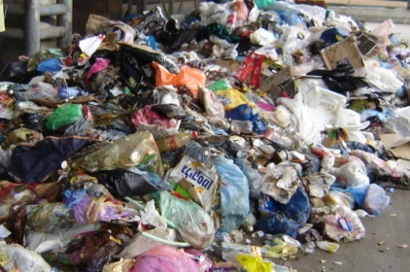
What is waste?
Useless, unwanted or discarded material resulting from agricultural, commercial, communal and industrial activities.
Municipal Solid Waste (MSW) –term for solid waste discarded from residential and commercial establishments.
Solid Waste which do not generally carry any value to the first user(s).

Slide 21
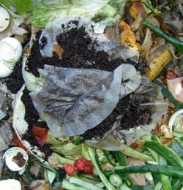
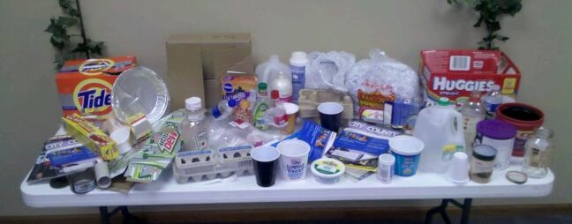
CLASSIFICATION OF SOLID WASTES
Solid wastes are classified on the basis of source of generation and type.
Source-based classification
Residential: wastes from dwellings, apartments, etc.,
Consists of leftover food, vegetable peels, plastic, clothes, ashes, etc.

Slide 22
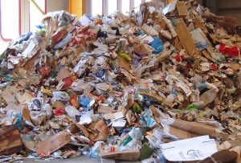
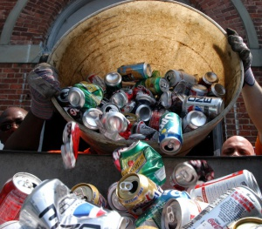
(ii) Commercial: wastes consisting of leftover food, glasses, metals, ashes, etc.,
generated from
- stores,
- restaurants,
- markets,
- hotels,
- motels,
- auto-repair shops,
- medical facilities, etc.

Slide 23
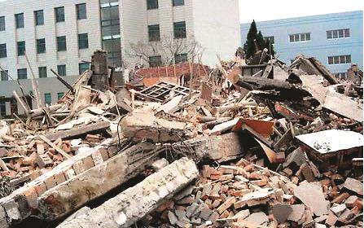
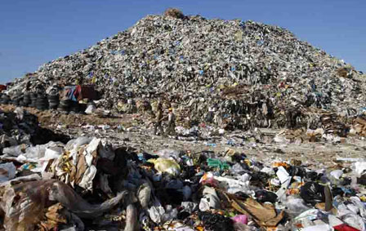
(iii) Institutional: This mainly consists of paper, plastic, glasses, etc., generated from educational, administrative and public buildings such as schools, colleges, offices, prisons, etc.
(iv) Municipal: This includes dust, leafy matter, building debris, treatment plant residual sludge, etc., generated from various municipal activities like construction and demolition, street cleaning, landscaping, etc.
(Note, however, in India municipal can typically subsume items at (i) to (iii) above).

Slide 24
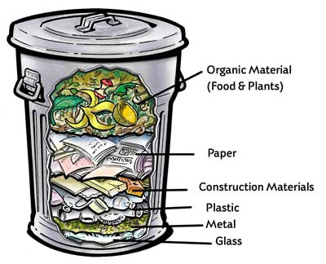

Slide 25
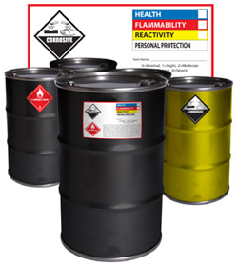
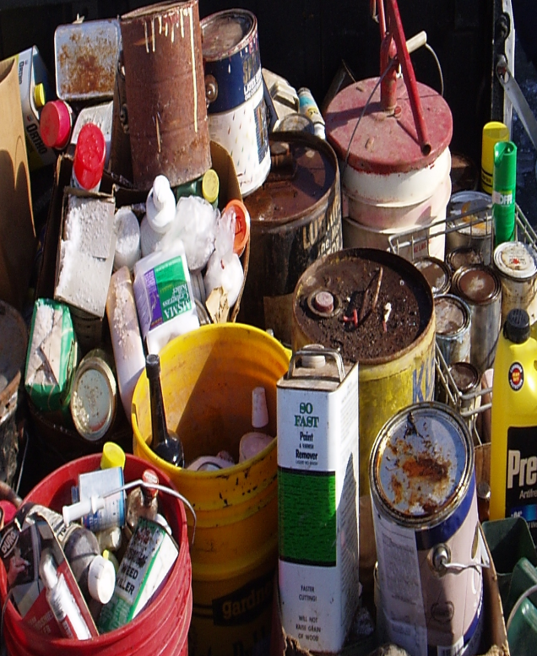
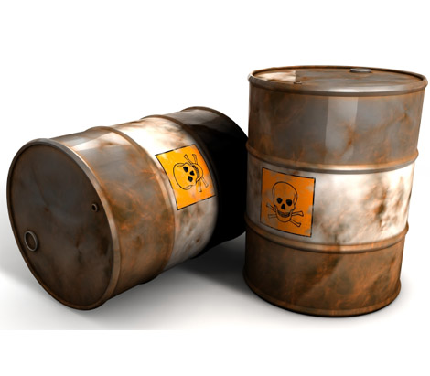
(v) Industrial: This mainly consists of process wastes, ashes, demolition and construction wastes, hazardous wastes, etc., due to industrial activities.

Slide 26
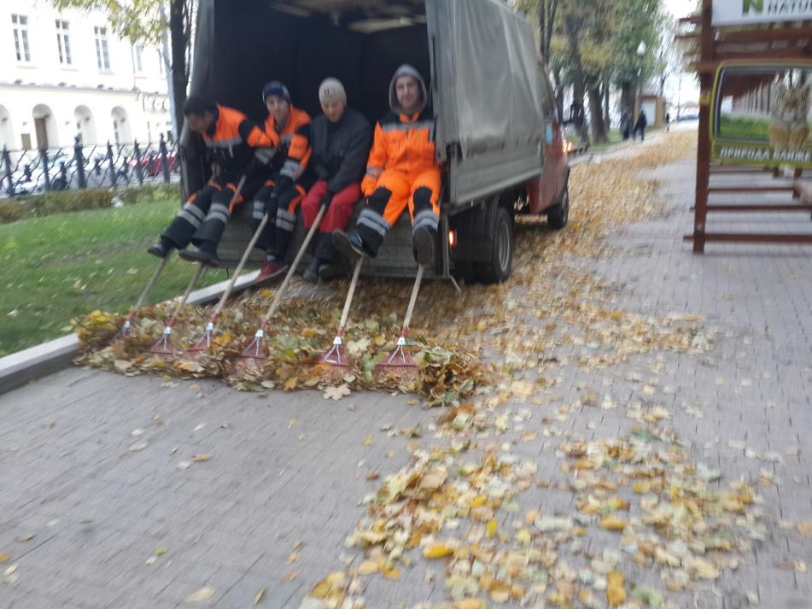
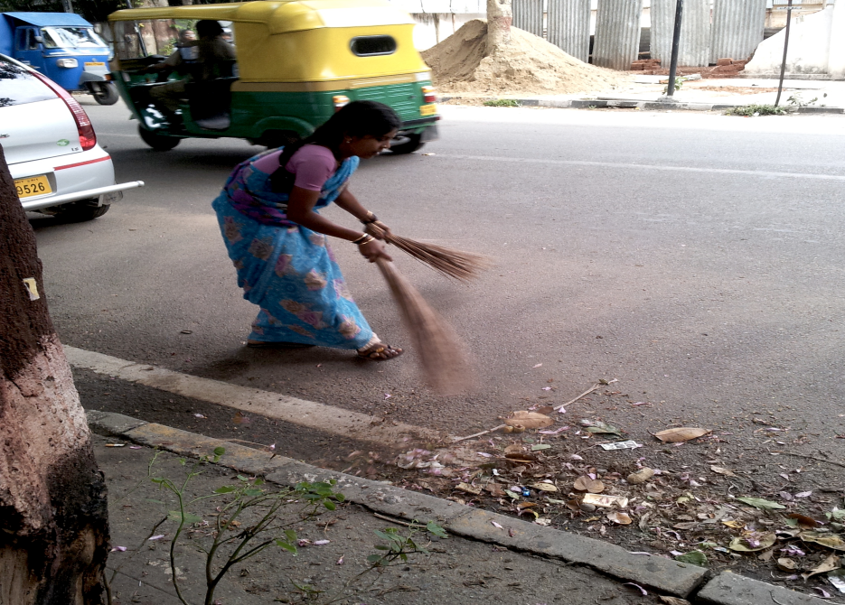
(vi) Agricultural: This mainly consists of spoiled food grains and vegetables, agricultural remains, litter, etc., generated from fields, orchards, vineyards, farms, etc.
(vii) Open areas: this includes wastes from areas such as streets, alleys, parks, vacant lots, playgrounds, beaches, highways, recreational areas, etc.

Slide 27
Type-based classification
Classification of wastes based on types, i.e., physical, chemical, and biological characteristics of wastes, is as follows
Garbage: This refers to animal and vegetable wastes resulting from the handling, sale, storage, preparation, cooking and serving of food.
These wastes contains putrescible organic matter, which produces an obnoxious odour and attracts rats and other vermin.
It, therefore, requires special attention in storage, handling and disposal.

Slide 28
(ii) Ashes and residues:
These are substances remaining from the burning of wood, coal, charcoal, coke and other combustible materials for cooking and heating in houses, institutions and small industrial establishments.
When produced in large quantities, as in power-generation plants and factories, these are classified as industrial wastes.

Slide 29
(iii) Combustible and non-combustible wastes:
These consist of wastes generated from households, institutions, commercial activities, etc., excluding food wastes and other highly putrescible material.
Typically, combustible material consists of paper, cardboard, textile, rubber, garden trimmings, etc., Non-combustible material consists of such items as glass, crockery, tin and aluminium cans, ferrous and non-ferrous material and dirt.

Slide 30
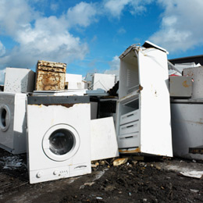
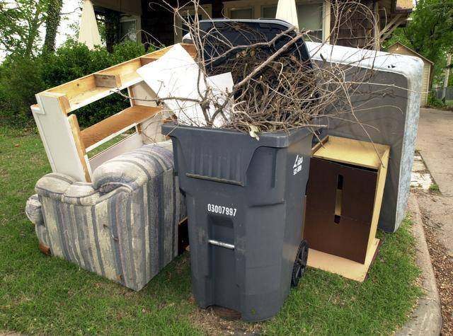
(iv) Bulky wastes:
These include large household appliances such as refrigerators, washing machines, furniture, crates, vehicle parts, tyres, wood, trees and branches.
Since these household wastes cannot be accommodated in normal storage containers, they require a special collection mechanism.

Slide 31
(v) Street wastes:
wastes that are collected from streets, walkways, alleys, parks and vacant plots, and include paper, cardboard, plastics, dirt, leaves and other vegetable matter.
(vi) Biodegradable and non-biodegradable wastes:
Biodegradable - leftover food, vegetable and fruit peels, paper, textile, wood, etc., generated from various household and industrial activities.
non-biodegradable - inorganic and recyclable materials such as plastic, glass, cans, metals, etc.

Slide 32
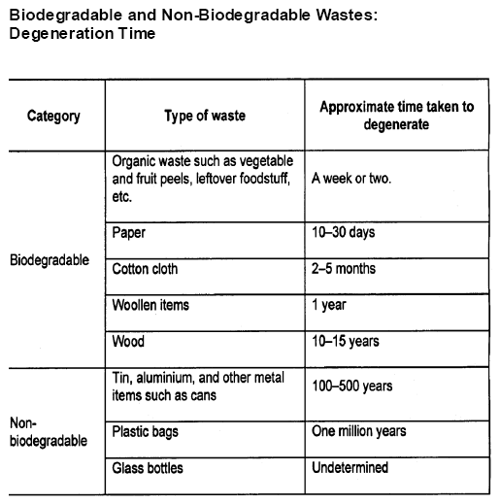

Slide 33
(vii) Dead animals
(viii) Abandoned vehicles
(ix) Construction and demolition wastes
Consist mainly of earth, stones, concrete, bricks, lumber, roofing and plumbing materials, heating systems and electrical wires and parts of the general municipal waste stream.
(x) Farm wastes: These wastes result from diverse agricultural activities such as planting, harvesting, production of milk, rearing of animals for slaughter and the operation of feedlots.

Slide 34
(xi) Hazardous wastes:
defined as wastes of industrial, institutional or consumer origin.
They are potentially dangerous either immediately or over a period of time to human beings and the environment.
This is due to their physical, chemical and biological or radioactive characteristics like
  - Ignitability,
- Corrosivity,
- Reactivity and - Toxicity.

Slide 35
Typical examples of hazardous wastes are
- empty containers of solvents,
- paints and pesticides which are frequently mixed with municipal wastes and become part of the urban waste stream.
Certain hazardous wastes may cause explosions in incinerators and fires at landfill sites.
Others such as pathological wastes from hospitals and radioactive wastes also require special handling.
Effective management practices should ensure that hazardous wastes are stored, collected, transported and disposed of separately, preferably after suitable treatment to render them harmless.

Slide 36
(xii) Sewage wastes:
The solid by-products of sewage treatment are classified as sewage wastes.

Slide 37
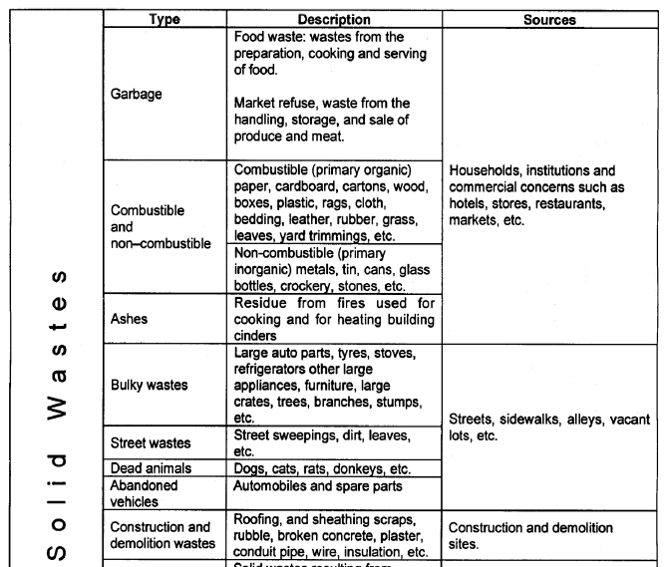

Slide 38
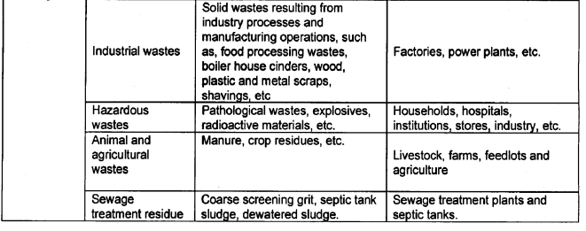

Slide 39
Waste generation
The processing of raw materials is the first stage when wastes are generated, and waste generation continues thereafter at every step in the process as raw materials are converted into final products for consumption.
Figure below shows a simplified material-flow diagram indicating the path of generation of solid wastes.

Slide 40
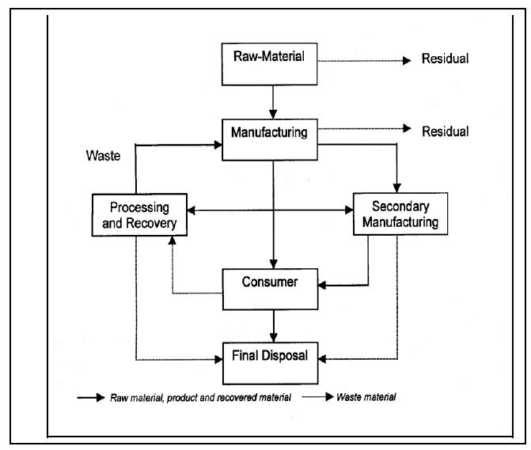
Material Flow and Waste

Slide 41
The above figure suggests that we can reduce the amount of solid waste by limiting the consumption of raw materials and increasing the rate of recovery and reuse.
Therefore, there needs to be, a societal change in the perception of wastes.
But, implementing changes in the society is difficult, unless appropriate management solutions are provided.

Slide 42
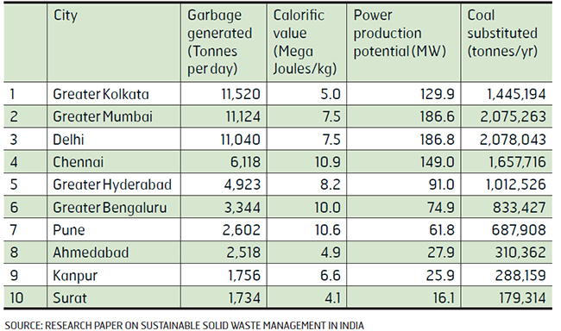
Waste generation in india

Slide 43
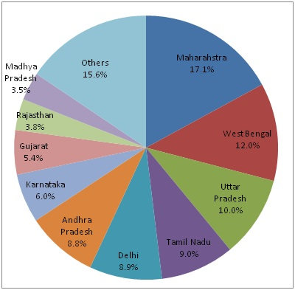

Slide 44
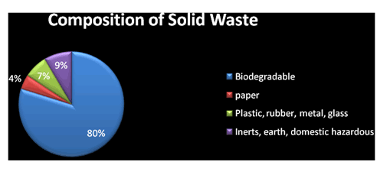
Waste composition
Waste composition varies with the socio-economic status within a particular community,
since income, determines life style, composition pattern and cultural behaviour

Slide 45
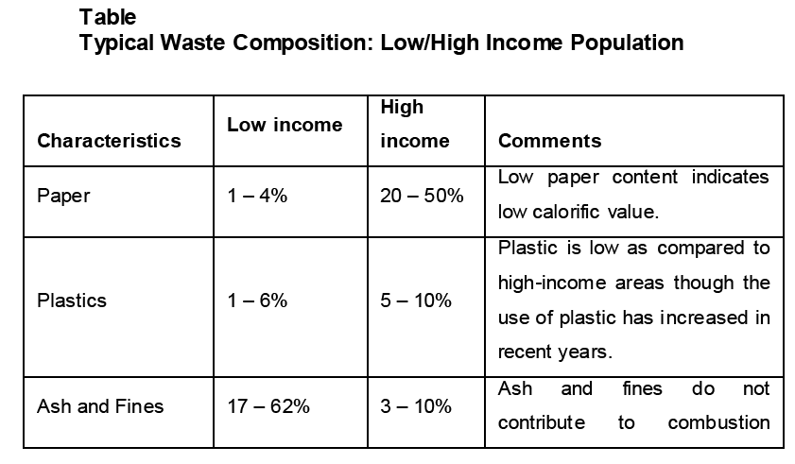
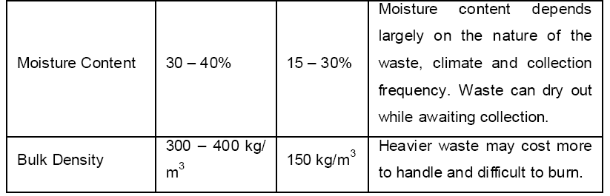
Waste composition in India
process
process

Slide 46
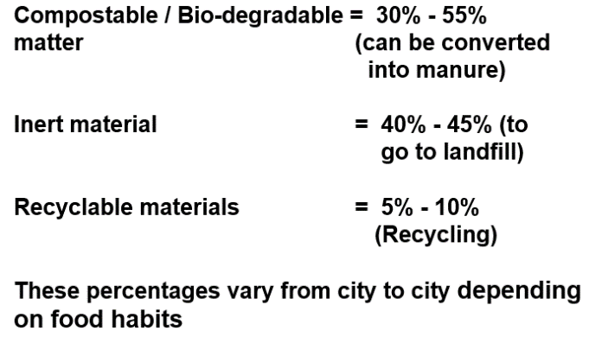
Characteristics of solid waste generated from urban areas in India Source: Presentation on Solid Waste Management in India, IIT Madras

Slide 47
Waste composition also depends on
- moisture content,
- density and
- relative distribution of municipal wastes.
Important for the characterisation of solid waste for most applications.

Slide 48
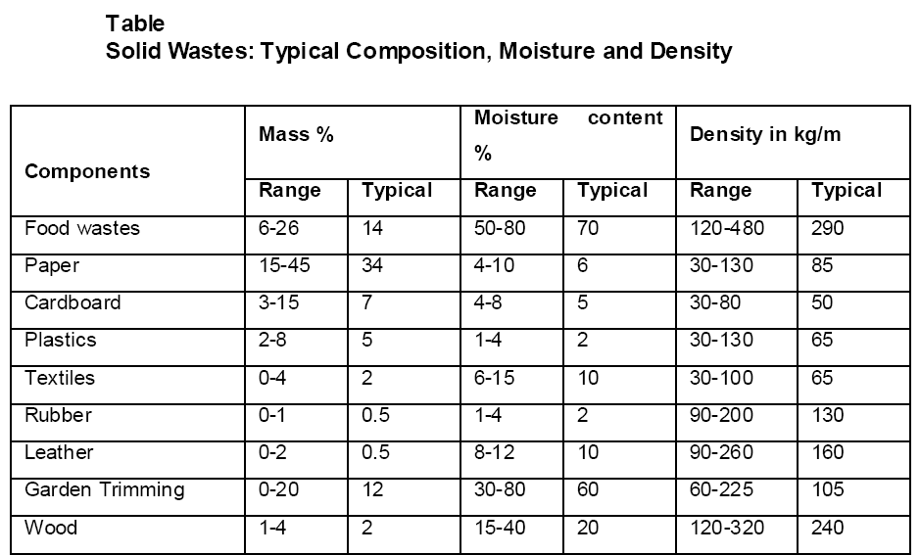

Slide 49

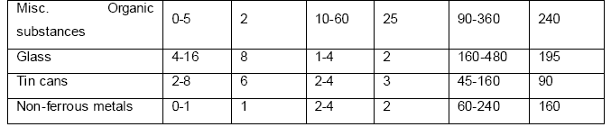
Contin….

Slide 50
Factors affecting generation of solid wastes
There are several factors, which affect the present as well as the future waste quantity and composition.
Geographic location:
Warmer southern areas, where the growing season is considerably longer compared to the northern areas, yard wastes are collected in considerably larger quantities and over a longer period of time.

Slide 51
2. Seasons:
Seasons of the year have implications for the quantities and composition of certain types of solid wastes.
For example, the growing season of vegetables and fruits affect the quantities of food wastes.
3. Collection frequency
4. Population diversity
5. Public attitude
6. Legislation

Slide 52
WASTE CHARACTERISTICS
To identify the exact characteristics of municipal wastes, it is necessary that we analyse them using physical and chemical parameters.
Physical characteristics:
Physical characteristics of solid wastes are important for the selection and operation of equipment and for the analysis and design of disposal facilities.

Slide 53
Density:
It is a critical factor in the design of a SWM system,
To explain, an efficient operation of a landfill demands compaction of wastes to optimum density.
Any normal compaction equipment can achieve reduction in volume of wastes by 75%, which increases an initial density of 100 kg/m³ to 400 kg/m³.

Slide 54

(ii) Moisture content
A typical range of moisture content is 20 to 40%.

Slide 55
(iii) Size:
Measurement of size distribution of particles in waste stream is important because of
- its significance in the design of mechanical separators and shredders.

Slide 56
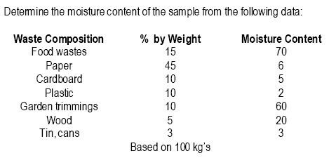
Problem:

Slide 57
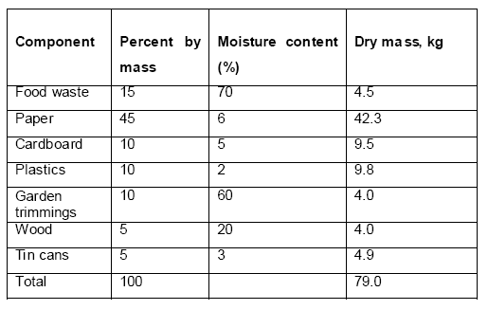
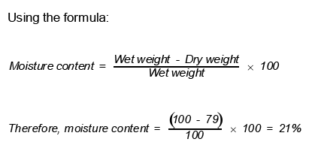
Solution:

Slide 58
Chemical characteristics
If solid wastes are to be used as fuel, or are used for any other purpose, we must know their chemical characteristics, including the following:
(i) Lipids
This class of compounds includes fats, oils and grease, and the principal sources of lipids are garbage, cooking oils and fats.
Lipids have high heating values, about 38,000 kJ/kg (kilojoules per kilogram), which makes waste with high lipid content suitable for energy recovery.
They are biodegradable, the rate of biodegradation is relatively slow because lipids have a low solubility in water.

Slide 59
(ii) Carbohydrates
These are found primarily in food and yard wastes, which encompass sugar and polymer of sugars (e.g., starch, cellulose, etc.) with general formula (CH₂O)_{x}.
Carbohydrates are readily biodegraded to products such as carbon dioxide, water and methane.
Decomposing carbohydrates attract flies and rats, and therefore, should not be left exposed for long duration.

Slide 60
(iii) Proteins
These are compounds containing carbon, hydrogen, oxygen and nitrogen, and consist of an organic acid with a substituted amine group (NH₂).
They are mainly found in food and garden wastes.
The partial decomposition of these compounds can result in the production of amines that have unpleasant odours.

Slide 61
(iv) Natural fibres
Found in paper products, food and yard wastes.
Includes natural compounds, cellulose and lignin, that are resistant to biodegradation.
Highly combustible solid waste, having a high proportion of paper and wood products, they are suitable for incineration.
Calorific values of oven-dried paper products are in the range of 12,000 -18,000 kJ/kg and of wood about 20,000 kJ/kg, i.e., about half that for fuel oil, which is 44,200 kJ/kg.

Slide 62
(v) Synthetic organic material (Plastics): 1 – 10%
Significant component of solid waste in recent years.
Highly resistant to biodegradation therefore, objectionable and of special concern in SWM.
Increasing attention being paid to recycling of plastics to reduce the proportion of this waste component at disposal sites.
Plastics have a high heating value, about 32,000 kJ/kg, suitable for incineration.
But PVC, when burnt, produces dioxin and acid gas. The acid gas increases corrosion in the combustion system and is responsible for acid rain.

Slide 63
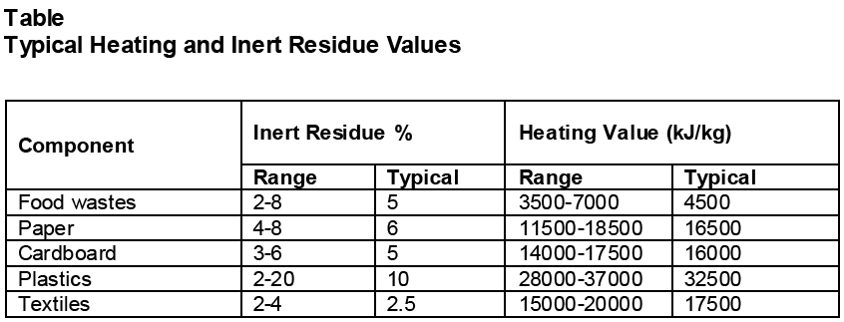
(vi) Non-combustibles
Includes glass, ceramics, metals, dust and ashes, and accounts for 12 – 25% of dry solids.
(vii) Heating value : Bomb calorimeter test

Slide 64
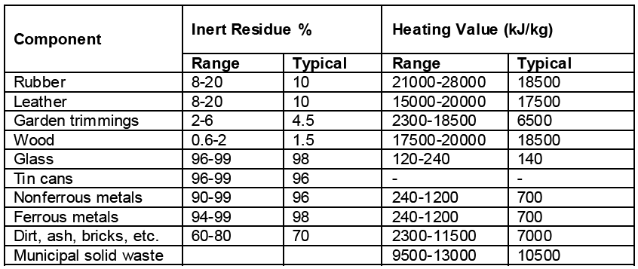
Table Contin….

Slide 65
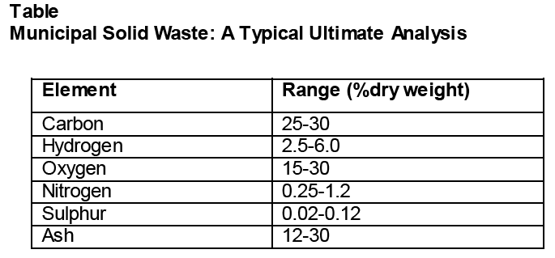
(viii) Ultimate analysis

Slide 66
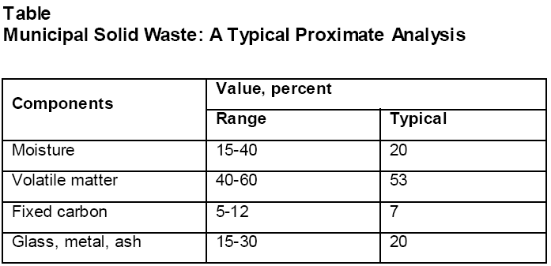
(ix) Proximate analysis

Slide 67
WASTE STREAM ASSESSMENT (WSA) (Methods of sampling and characterization)
To determine quantity (i.e., the amount of waste generated in the community, both in terms of weight and volume), composition (i.e., the different components of waste stream) and sources of wastes.
Waste stream assessment is not a one-time activity. It is a continuous and dynamic process, because the characteristics of wastes differ depending on the regions, communities, seasons, etc.

Slide 68
The reasons for the analysis of waste composition, characteristics and quantity include the following
It provides the basic data for the planning, designing and operation of the management systems.
The data helps detect changes in composition, characteristics and quantities of wastes, and the rates at which these changes take place,
which facilitates effective implementation of management systems.

Slide 69
(iii) It quantifies the amount and type of materials suitable for processing, recovery and recycling.
(iv) It provides information that helps in deciding appropriate technologies and equipment.
(v) The forecast trends assist designers and manufacturers in the production of collection vehicles and equipment suitable for future needs.

Slide 70
WSA are carried out in the absence of reliable basic data in three ways:
Sorting of wastes,
Vehicle weighing at disposal sites and
Visiting institutional and industrial sites to identify wastes being generated and disposal methods.
(i) Waste sorting
Sorting of wastes at disposal sites for weighing and sampling in order to determine the percentage of each component and the physical and chemical characteristics of wastes.

Slide 71
It is carried out manually, and the sample size for analysis is between 100 and 150 kg.
The implements required for the purpose include
- sorting table,
- measuring box,
- bins or boxes to contain sorted materials and
- platform weighing machine.

Slide 72
The total quantity of waste collected is thoroughly mixed & then reduced by method of quartering till a sample of such size that can be handled in the laboratory.
Samples collected for physical and chemical analysis are double bagged in plastic bags, sealed & sent to laboratory for analysis with weight ranging 10 -12 kg.

Slide 73
(ii) Vehicle weighing:
Vehicles are weighed when they enter the disposal sites loaded, and exit the sites empty.
Weighing is carried out each day of the weighing period in order to determine the average weight.
The weighing of loaded and unloaded vehicles is accomplished with a weighing scale or weighbridge.
The quantity of waste measured at disposal sites reflects a disposal factor rather than a generation factor.

Slide 74
(iii) Field visits
Field visits involve visiting the facility, i.e., industry, institutions, etc., viewing the waste handling system and completing a questionnaire with the assistance of the plant manager or senior technical personnel.
Collection of samples in sealed polythene bags follows for laboratory analysis to identify physical and chemical characteristics.
Each sample may be in the range of 1.5 to 5 kg.

Slide 75
PUBLIC HEALTH AND ENVIRONMENTAL EFFECTS
An effective solid waste management system is necessary to avoid public health disasters, spread of disease by insects and vectors and adverse effect on water and air

Slide 76
Public health effect
The volume of waste increasing rapidly as a result of increasing population and improving economic conditions in various localities.
This increased volume of wastes is posing serious problems due to insufficient workforce and other constraints in disposing of it properly.

Slide 77
Disease vectors and pathways
Wastes dumped indiscriminately provide the food and environment for thriving populations of vermin, which are the agents of various diseases.
The pathways of pathogen transmission from wastes to humans are mostly indirect through insects – flies, mosquitoes and roaches and animals – rodents and pigs.
Diseases become a public health problem when they are present in the human and animal population of surrounding communities.

Slide 78
(ii) Flies
Most common in this category is the housefly, which transmits typhoid, salmonellosis, gastro-enteritis and dysentery.
(iii) Mosquitoes:
They transmit diseases such as malaria, filaria and dengue fever.
They breed in stagnant water, control measures should centre on the elimination of breeding places such as tins, cans, tyres, etc.

Slide 79
(iv) Roaches:
These cause infection by physical contact and can transmit typhoid, cholera and amoebiasis.
The problems of roaches are associated with the poor storage of solid waste.
(v) Rodents: Rodents (rats) proliferate in uncontrolled deposits of solid wastes, which provide a source of food as well as shelter.
They are responsible for the spread of diseases such as plague, murine typhus, leptospirosis, histoplasmosis, rat bite fever, dalmonelosis, trichinosis, etc.

Slide 80
(vi) Occupational hazards:
Workers handling wastes are at risk of accidents related to the nature of material and lack of safety precautions. It includes
skin and blood infections resulting from direct contact with waste and from infected wounds;
eye and respiratory infections resulting from exposure to infected dust, especially during landfill operations;
diseases that result from the bites of animals feeding on the waste;

Slide 81
intestinal infections that are transmitted by flies feeding on the waste;
chronic respiratory diseases, including cancers resulting from exposure to dust and hazardous compounds.
(vii) Animals:
Apart from rodents, some animals (e.g., dogs, cats, pigs, etc.) also act as carriers of disease.

Slide 82
Environmental effect
Inadequate and improper waste management causes adverse environmental effects such as the following:
Air pollution:
Burning of solid wastes in open dumps or in improperly designed incinerators emit pollutants (gaseous and particulate matters).
Emissions includes particulate matter, sulphur oxides, nitrogen oxides, hydrogen chloride, carbon monoxide, lead and mercury.
Discharge of arsenic, cadmium and selenium is to be controlled, since they are toxic at relatively low exposure levels.

Slide 83
(ii) Water and land pollution:
Water pollution results from dumping in open areas and storm water drains, and improper design, construction and/or operation of a sanitary landfill.
Pollution of groundwater can occur as a result of:
The flow of groundwater through deposits of solid waste at landfill sites;
Percolation of rainfall or irrigation waters from solid wastes to the water table;
Diffusion and collection of gases generated by the decomposition of solid wastes.

Slide 84
(iii) Visual pollution:
The aesthetic sensibility is offended by the unsightliness of piles of wastes on the roadside.
(iv) Noise pollution:
Undesirable noise is a nuisance associated with operations at landfills, incinerators, transfer stations and sites used for recycling.
(v) Odour pollution:
Obnoxious odours due to the presence of decaying organic matter are characteristic of open dumps.

Slide 85
(vi) Explosion hazards:
Landfill gas, which is released during anaerobic decomposition processes, contains a high proportion of methane (35 – 73%).
It can migrate through the soil over a considerable distance, leaving the buildings in the vicinity of sanitary landfill sites at risk, even after the closure of landfills.

Slide 86
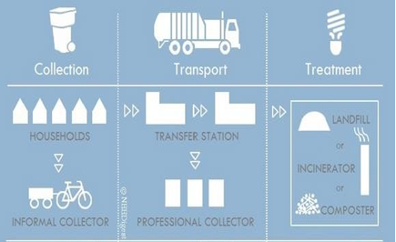
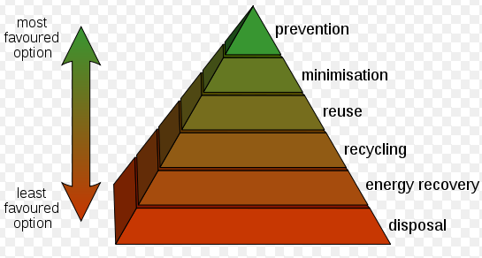
SOLID WASTE MANAGEMENT
Steps in management of solid waste
Waste management hierarchy

Slide 87
Steps in management of solid waste
Generation
Collection
- On-site handling and storage
Handling and separation
Transfer and transport
Treatment facilities
-Incineration
-Composting
-Landfill

Slide 88
Solid waste management (SWM) is associated with the control of
- waste generation,
-its storage,
-collection,
-transfer and transport,
-processing and disposal in a manner that is in accordance with the best principles of - public health, economics, engineering, conservation, aesthetics, public attitude and other environmental considerations.

Slide 89
SWM depending on economic status, degree of industrialisation, social development (e.g., education, literacy, healthcare, etc.) and quality of life of a location.
In addition, regional, seasonal and economic differences influence the SWM processes.
Therefore, the management strategies that are economically viable, technically feasible and socially acceptable to carry out such of the functions as are listed below

Slide 90
Protection of environmental health.
Promotion of environmental quality.
Supporting the efficiency and productivity of the economy.
Generation of employment and income.

Slide 91
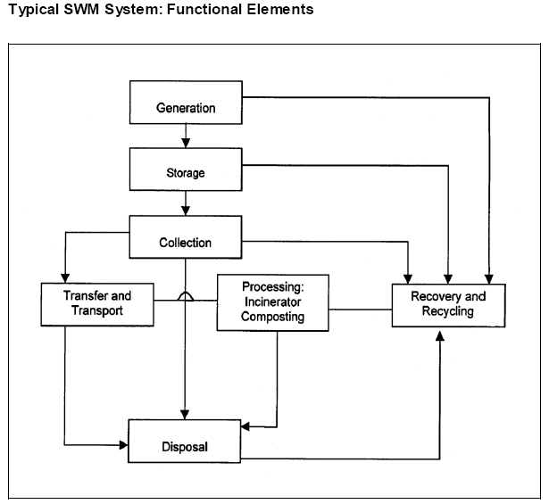

Slide 92
PUBLIC AWARENESS AND TRAINING
Public awareness is an important activity in Solid Waste Management to keep the system sustainable.
Training to Ward Councilors
Partnership Role for Public Awareness
1. NGO
2. CBO

Slide 93
Mode of Implementing Public Awareness Programs
1. Audio & Video program
2. IEC program
3. Child to child education
4. School education

Slide 94
Total number of sweepers allotted for door to door waste collection work in each ward.
Number of sweepers getting good response from citizens in the matter of doorstep collection.
Number of sweepers not getting response from the public.
Percentage of public participation
Improvement in this area over the last month.

Slide 95
Role of NGOs
Many NGOs are committed to improve SWM practices in urban areas.
They developed good mass-communication skills and education programs for the public.
Such NGOs may support the new strategies adopted by the local body and associate in public awareness.
NGOs may fully involved in creating public awareness and encouraging public participation in SWM planning and practice.

Slide 96
The local body also encourage NGOs to enter this field and organise rag pickers in doorstep collection of waste and provide an opportunity to improve their working conditions and income.
The local body can give incentives to NGOs in their effort of organising rag pickers in primary collection of recyclable and/or organic waste, and provide financial and logistic support to the extent possible.

